Slide 1
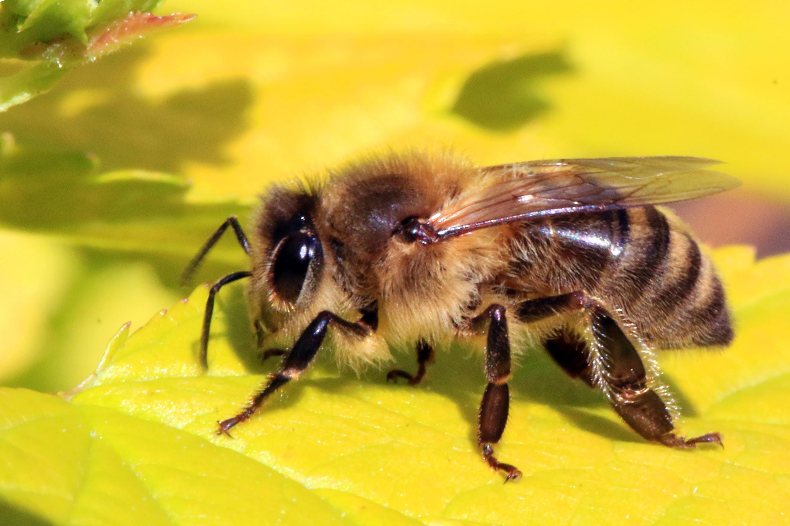
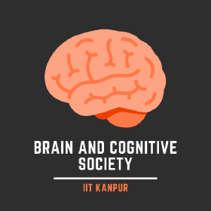
Connectome Project
Brain and Cognitive Society,
IIT Kanpur
Visual System:
The Bumblebee
Presentation by Abhinaya, Vatsal, Navya, Shubham

Slide 2
Bees’ Vision
Bee vision is also much faster than our vision.
Bees can see fast moving objects much better than we can, so they can easily distinguish between different objects such as varieties of flowers while flying.
In the frontal part of the eye, where the resolution is maximized, honey bees can clearly see objects that are as small as 1.9° - that's approximately the width of your thumb when you stretch your arm out in front of you.
In terms of the smallest object a bee can detect, but not clearly, this works out to be about 0.6° - that's one third of your thumb width at arm's length.

Slide 3
Honey bees have a relatively modest average angular sensitivity of 2.6°. we found that even single photoreceptors have sufficient acuity and contrast sensitivity to detect objects around 0.5° across - substantially smaller than the angle subtended by each ommatidium.
Optical data suggests that bees have interommatidial angles (Δϕ) of 2.1° (horizontally) and 0.9° (vertically) in this eye region.

Slide 4
Colors visible to the bees’ eyes
Bees are trichromatic like the humans, this means they have three types of photoreceptor cells for three different colors – blue, green, and ultraviolet.
Bees, like many insects, see from approximately 300 to 650 nm. That means they can’t see the color red, but they can see in the ultraviolet spectrum (which humans cannot).
All the color combinations they see are based on those three colors.

Slide 5
Bees cannot see in complete darkness.
Bees can also easily distinguish between dark and light – making them very good at seeing edges.
Many flowers have distinctive ultraviolet color patterns that are invisible to the human eye, but are incredibly eye-catching to bees.
Bees can also see a color called the bee’s purple, which is a combination of yellow and ultraviolet light.
Their color vision is the fastest in the animal world, five times faster than humans. So while we may have trouble distinguishing one flower in a group from another, bees don’t.

Slide 6
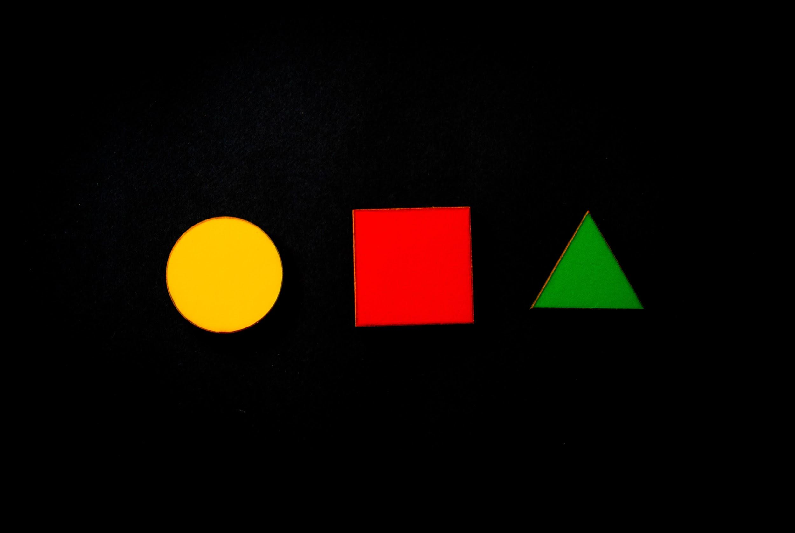
Do bees see shapes?
Many experiments were conducted with different colors, patterns, textures with rewarding and non-rewarding parts which showed the following results.
Bees do not remember shapes as whole shapes, although they discriminate between two shapes.
The bees learn first the most preferred cue, even if they learn to avoid it. This can give the false impression that they learn to prefer the rewarded pattern.
When presented with a choice between two patterns, one of which is rewarded and the other not, the bees ignore most of the cues because they are displayed on both targets. The bees learn them on one target and unlearn them on the other.

Slide 7
They also could not remember that they were rewarded on the large spot or a scattering of 40 small spots of the same colour with a total area the same as the area of the large spot.
They had learned only the colour cue, not its shape, position or modulation. The trained bees scarcely notice if the colours are reversed.
They could scarcely distinguish the training target from its mirror image.
Further experimentation revealed that our initial mistake in the intuitive conclusion that the bees had learned the shapes and the colours.
however, that bees cannot learn two colours, it was shown that the bees could learn a difference between the same two colours.

Slide 8

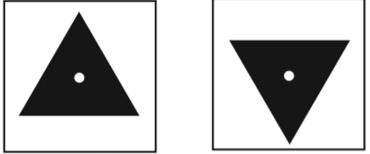
What about symmetry?
Bees discriminate the inversion of the black triangle if the centres are at different positions in the vertical direction.
They fail to learn when the centres are at the same height.

Slide 9
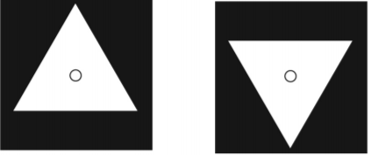


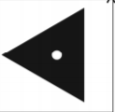
They also fail to discriminate when black and white are interchanged.
They have difficulty discriminating the rotation of a square.
The rotation of the same triangle is easily discriminated when one edge is vertical.

Slide 10

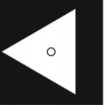
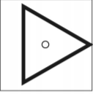
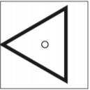


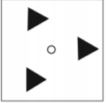
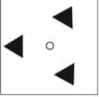
Can bees distinguish mirror images?
The trained bees discriminate when black and white are interchanged, when only the edges are displayed or when the triangles are smaller.
(a) (b) (c)
The differing positions of the areas at the corners have little effect.

Slide 11
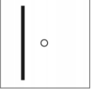
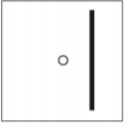
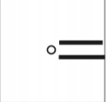

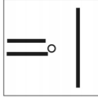
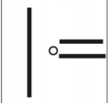
The bees were tested with isolated horizontal edges and also with vertical edges on one side of the target and horizontal edges on the other side, with surprising success.

Slide 12


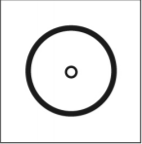
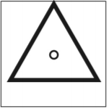
Difference between a triangle and a disc
The bees can easily distinguish a small triangle and a disc.
They could also distinguish them through isolated edges.
However they were unable to tell the difference between a
Inverted triangle and a normal one.

Slide 13

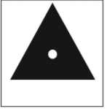
When white oblique lines were drawn on the disc, however, the bees could not distinguish it from the triangle
This showed that they did not need to learn the positions of the oriented edges which directly demonstrated that they had not learned the shape of either the disc or the triangle.

Slide 14


Understanding patterns
To answer such questions many experiments were conducted, one of which was the ring versus a large spot.
The bees were trained on fixed patterns in which the cue was the black near the centre.

Slide 15
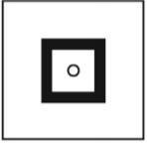



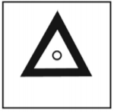
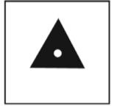


The bees cared nothing about the shapes presented as long as there was a difference in black around the reward hole, which hinted that the bees could identify the pattern.
When the cue(the black near the centre) was lacking, the bees failed, irrespective of the test shapes.

Slide 16




Topological differences between objects
To answer this question a experiment was conducted on a thick black O and a large letter S. The bees learned the unrewarded pattern. The bees learnt to avoid the letter S more than O.
The cue was not related to the topology of the shapes. The bees preferred the distorted O over the 8.

Slide 17

The bees cannot differentiate between the 8 and the large S either.
The mirror image of the S was weakly discriminated from the S, which suggested that there was an additional cue beside the black near the centre.
Further tests showed that white near the reward hole was preferred to black near the reward hole irrespective of the rest of the pattern.

Slide 18

The bees failed to discriminate the oblique bar versus the S (Figure 11.10i). They had certainly not learned the shape of the S.
Taken all together, the results were consistent with the detection of two cues already familiar from earlier work and did not learn the difference in the topology of the O and the S.

Slide 19
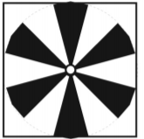
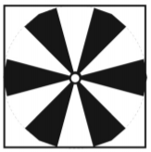

Can Bees Identify Sector Patterns?
Bees were trained on two patterns of six sectors— one rotated by half a period relative to the other.
It was most interesting to discover that the trained bees failed to recognize the rewarded pattern versus the same pattern that was seriously rearranged

Slide 20



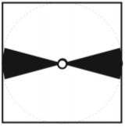
The trained bees failed when the horizontal sectors were removed from the training patterns.
But they discriminated very well when only the horizontal sectors were displayed. So, after 25 years of support for eidetic vision, when the tests were done the positions of the horizontal sectors on the negative target were a sufficient cue.

Slide 21
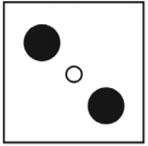
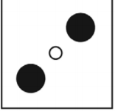
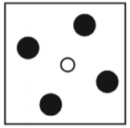
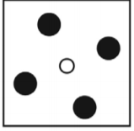
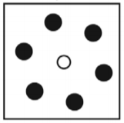
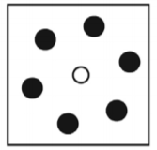
Do they identify patterns related to spots?
The bees can distinguish between two spots and three of the same total area and something about their positions.
This depends strongly on the size of the spots but is reduced as the number of spots is increased and also depends on the size of the targets and is improved when the spots fall into different local regions of the eye.

Slide 22
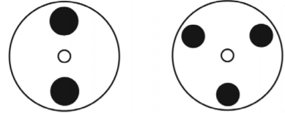
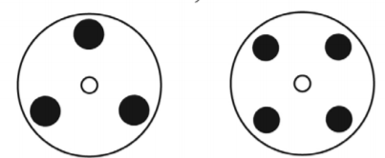
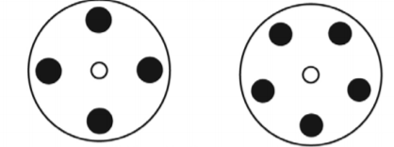
When the patterns are rotated randomly , the bees cannot even learn to distinguish between two spots and three of the same total area, no matter how large the targets or how long they are trained.
Even the difference between two and three spots could not be learned.

Slide 23


Can Bees recognize 3D Shapes?
The experimental results showed that bees can successfully recognize the three-dimensional form of objects and surfaces, independent of pictorial cues or outer shape.
Bees can discriminate between geometric objects such as a ball, a flat cylinder, a cube, and a cuboid. indicating that recognition did not depend on the detection of vertices alone.
They can distinguish them independently of their height, or the presence of distinct shape features .

Slide 24
This suggested that they had access to the depth profiles of the stimuli.
Experiments also showed that the bees did not rely on texture gradients or shadows for the discrimination.
It has also been shown that bees seem to find it harder to discriminate concave from convex stimuli than concave or convex from the planar stimulus.
Lacking sufficient stereo vision, bees are known to use speed gradients in optic flow to detect edges.
bees use the polarisation pattern of skylight and the analysis of optic flow fields from both eyes to navigate safely through their environment.

Slide 25
Perceiving movements in their surroundings
Bees identify the depth profile not only from velocity cues in the optic flow patterns but also by detecting features such as discontinuities at edges.
For pure translation, the parallax profiles for different 3-D stimuli are always in the range of negative displacements, with a maximum or minimum amplitude in the stimulus centre.
For translation plus rotation, the lateral stimulus regions move behind or in front of the fixated and hence static image point (central part of the stimulus, i.e. closest point for convex, most distant point for concave stimuli), thus generating image displacements in opposite directions.

Slide 26
Presenting photographic images of the three-dimensional stimuli revealed that the bees did not rely for this task on pictorial cues, such as texture gradients or shadows .
Shadows would not provide sufficient information for the bees to use as a cue to determine the depth profiles.
Instead data suggest that bees use the information from motion parallax to extract the depth profiles of the stimuli.
Bees deploy self-induced motion signals to accurately distinguish planar, convex and concave depth profiles.

Slide 27
The particular flight manoeuvres (translations and rotations), which we observe in bees flying in front of a stimulus, could reflect an optimized vision-motor strategy to extract the depth structure from optic flow.
The flight patterns of bees are highly adapted to provide several kinds of information:
(1) navigation related information for estimating the position of a stimulus in space, possibly using the lateral eye regions
(2) stimulus related information for identifying the 3D form of a stimulus, likely using the high-resolution of the frontal eye regions (for a review of other active vision strategies in bees see for example).

Slide 28
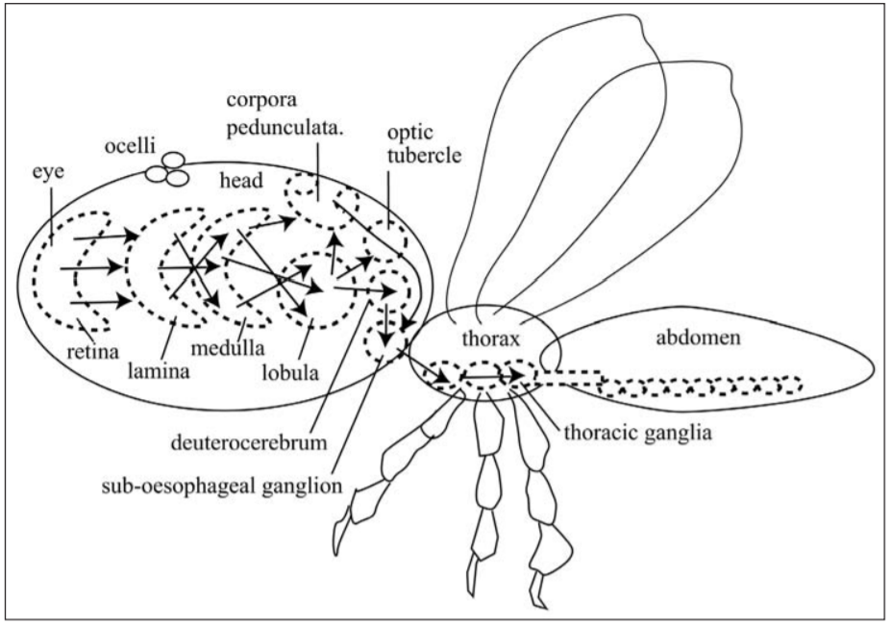
Processing of colors in bees’ eyes
Behind the retina there are three successive neural regions, crowded with dendrites and synapses, called respectively the lamina, medulla and lobula.

Slide 29
The regions are separated by tracts of axons and are the result of the growth of the eye at the edges, so that groups of local circuits are reduplicated side by side in columns to form successive arrays of dendrites in layers.
From the retina at least as far as the lobula, each successive layer is a retinotopic array with a different function in processing the parallel inputs, so the layers are successive stages of processing.
The basic unit of the inward pathways is the column of neurons corresponding with each ommatidium, with at least 10 synaptic relays between the visual input and the motor output. We now have neuron recordings at about eight different levels.

Slide 30
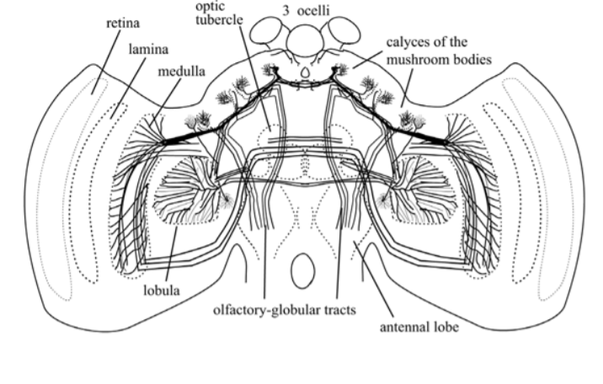
Tracts from the lobula continue to the optic tubercle, the calyces of the mushroom bodies and to motor centres of the neck, and finally in descending tracts to the segmented groups of neurons and motor centres of the ventral ganglia.

Slide 31
Processing in the Lamina
The lamina of the bee is essentially the pre-processing neuron layer immediately below the retina.
The exact 1:1 projection from each ommatidium to each cartridge of the lamina is continued through the lamina to each column of the medulla.
The lamina cartridges are packed side by side.
Each consists of eight to ten neurons of which about five are lamina monopolar cells (LMCs), at least three of which have no spikes.

Slide 32
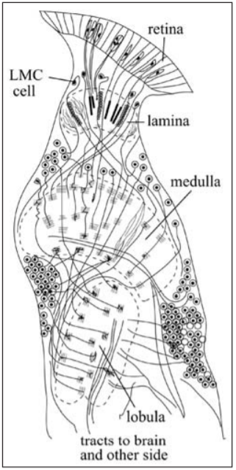
Each LMC has a distal cell body, local dendrite
in the lamina and an axon crossing in the first
chiasma to the medulla.

Slide 33
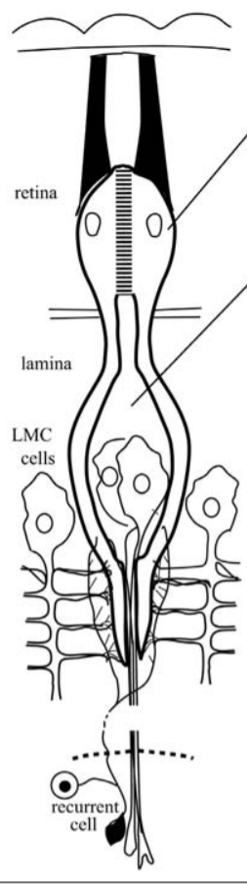
Responses of large second-order cells (LMC 1–3)
The lamina cells detect spatial contrasts.
As a bright spot passes, the retinal cells give a depolarizing
response and the large lamina neurons give a hyperpolarizing graded response to an increase in intensity, but ignore the background intensity.

Slide 34
The retinal cells track intensity or photon flux and respond with a graded depolarization.
The LMC membrane is a passive integrator with no local voltage-sensitive channels and the postsynaptic gain is independent of light adaptation.
In bees that there is a well-developed color coding among the lamina ganglion cells, sometimes with antagonistic effects of different wavelengths.
The large LMCs behave as though their visual world consists of rapidly repeated moving contrasts. Their small circular fields provide the best compromise of high spatial and high temporal resolution.

Slide 35
Colour in the lamina
To discriminate colour requires that the receptor types have parallel, or at least predictable, intensity/response curves.
The first stage of colour processing always involves convergence of two colour types with an antagonistic interaction on a postsynaptic neuron.
In the lamina of the bee, recording is difficult, but there is some evidence of spectrally opponent cells, UV-sensitive cells, depolarising cells and spiking cells, while most recorded cells are green sensitive.

Slide 36
Five types of hyper-polarising monopolar lamina cells have been found, three of them driven directly by short retinula axons and one by collaterals of a long visual fibre.
The first (m1) sums several receptor types.
The second (m2) has a peak in the green and also in the ultraviolet and a surround that peaks at 360 nm.
The third (m3) has a peak similar to that of the 430 nm receptor; m4 has a peak in the green and also in the ultraviolet.
Finally, m5 has a peak similar to the 525 nm receptor.

Slide 37
Processing in the Medulla
Medulla is where the first real work of vision is done, making combinations of inputs and detecting their coincidences.
The principle is that the map of the visual world on the retina is reduplicated at an early stage into numerous and different successive maps, each of which is composed of its own type of feature detector.
These arrays receive the same inputs from the retina but process them differently.

Slide 38
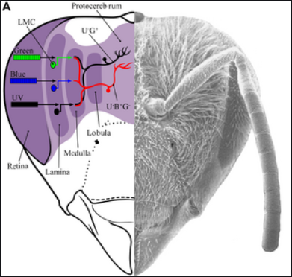
Six or more lamina neuron types, and the terminals of receptor cells seven and eight, project directly to the medulla.
The neurons of the medulla columns are numerous types of medium-field neurons, or sustaining units.

Slide 39
Locust Medulla Neurons
The common small-field neurons in the locust medulla are of three main types.
Linear sustaining cells that respond with graded potentials in opposite directions to ‘on’ and ‘off’, like LMC cells; They encode local intensity with various adaptation rates .
Non-linear transient cells that respond with spikes equally to ‘on’ and ‘off’ and are sensitive to motion in any direction rather than flicker.

Slide 40
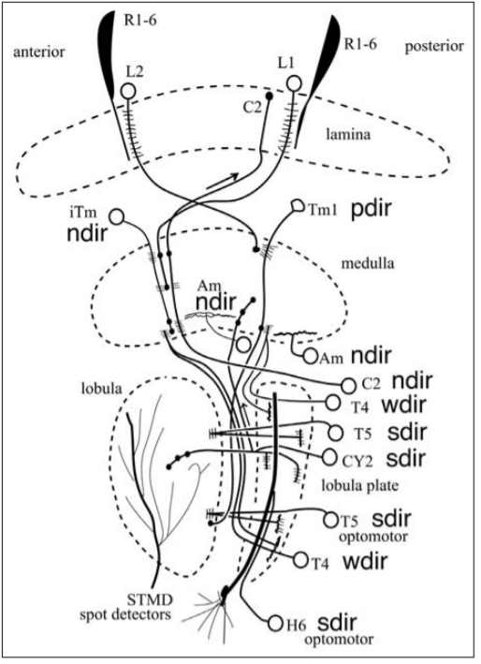
Directional motion-detector neurons with a variety of temporal and spatial constants, some are sensitive to either black/white or white/black edges.
The labelled cells have the following properties:
ndir = directional; pdir = partly directional;
sdir = strongly directional; wdir = weakly directional

Slide 41
Processing of Visual Information like Shapes
In terms of visual pathways in bees, the photoreceptors provide input from the eye to the lamina, which then sends its projections to the medulla. The medulla connects to the central brain and, in parallel, to a third-order visual processing center, the lobula, which then sends inputs via several tracts into the central brain.
Recent work in the honey bee lobula has shown that color and motion information are segregated along anatomical pathways, which are then integrated by the central brain.

Slide 42
The protocerebrum is a multimodal structure. In addition to visual information, olfactory and mechanosensory information are also sent to the lateral protocerebrum.
Hence, many of the neurons in the lateral protocerebrum likely respond to these additional modalities, which may alter the temporal dynamics of the visual responses of lateral protocerebral neurons.
The lateral protocerebrum also receives projections from the medulla and the lobula.
Anatomical mapping of the lateral protocerebrum in flies identified the existence of select centers (“glomeruli”) sensitive to visual stimulus orientation.

Slide 43
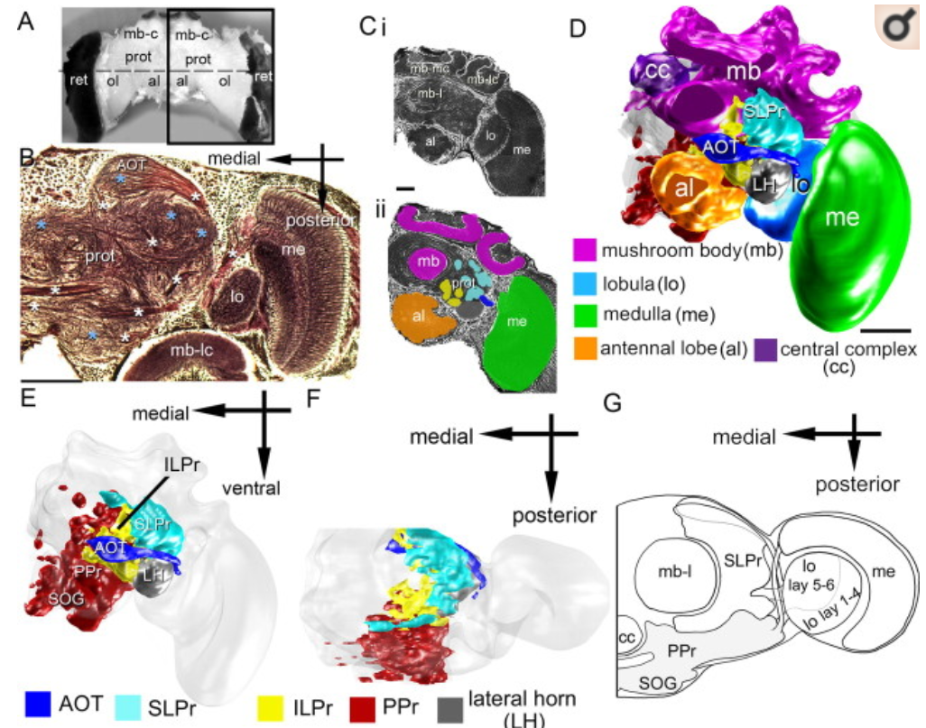
The lateral protocerebrum surrounds well defined anatomical structures [the mushroom bodies (magenta) and the central complex (purple)] and receives input tracts from the antennal lobes (orange) and the optic lobe regions: the medulla (green) and lobula (light blue).

Slide 44
There are five main regions in the lateral protocerebrum: the superior lateral protocerebrum (SLPr), the inferior lateral protocerebrum (ILPr), the posterior protocerebrum (PPr), the lateral horn (LH), and the anterior optic tubercle (AOT).
The SLPr, PPr, and ILPr were three spatially distinguishable clusters of glomeruli defined by location with respect to the dorsal–ventral and anterior–posterior axes.
The SLPr was in the dorsal–anterior area of the brain ( cyan), the ILPr was ventral and posterior to the SLPr ( yellow), and the PPr was posterior and ventral to the SLPr and ILPr ( red).

Slide 45
The SLPr and ILPr together span much of the anterior-medial axis of the lateral protocerebrum, and thus neurons projecting into the anterior lateral protocerebrum were in the dorsal (SLPr) or ventral (ILPr) anterior lateral protocerebrum.
The input to the protocerebrum from the medulla and lobula neurons is also segregated along the anterior–posterior axis.
The spatial information present in topographically arranged neuropils such as the retinotopic lamina, medulla, and (outer) lobula is most likely transformed in the glomerular protocerebrum, although the advantage of this arrangement is unknown.

Slide 46
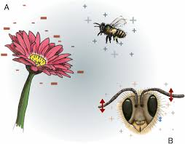
Recognition skills in bees
Scientists from the University of Bristol recently discovered
that bees can sense a flower’s electric field.
Bees build up a +ve charge as they buzz to the air
and the flowers are slightly -ve.
This makes the pollen stick to the bees like an
electric velcro.
This way, bees can even figure out if the flowers had any previous visitors who slurped up all the sweet stuff!

Slide 47
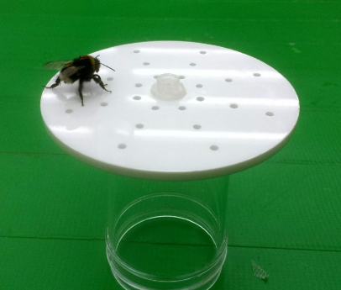
Pattern detection
A recent experiment indicates that bees might indeed be able to summon up the features of a pattern without the pattern being present.
Bees were first trained to distinguish two types of artificial
flowers that were visually identical, but which had ‘invisible
patterns’ made up of small scented holes that were either
arranged in a circle or in a cross.
The bees were able to figure out these patterns by using
their feelers (antenna ).
Then, these patterns were suddenly made visible by the
experimenter (so that the flowers now displayed
visual circles or crosses).

Slide 48
What happened then?
Result:
Bees instantly recognised the image that was formerly just an ephemeral smell-pattern in the air.
And were able to differentiate between the flowers after the patterns were made visible.
Inference:
This indicates that the bees might indeed have a mental representation of the shape, rather than recognising patterns based on simple feature-detectors in their visual system. They were able to memorise the scented pattern in the air when they were trained.

Slide 49
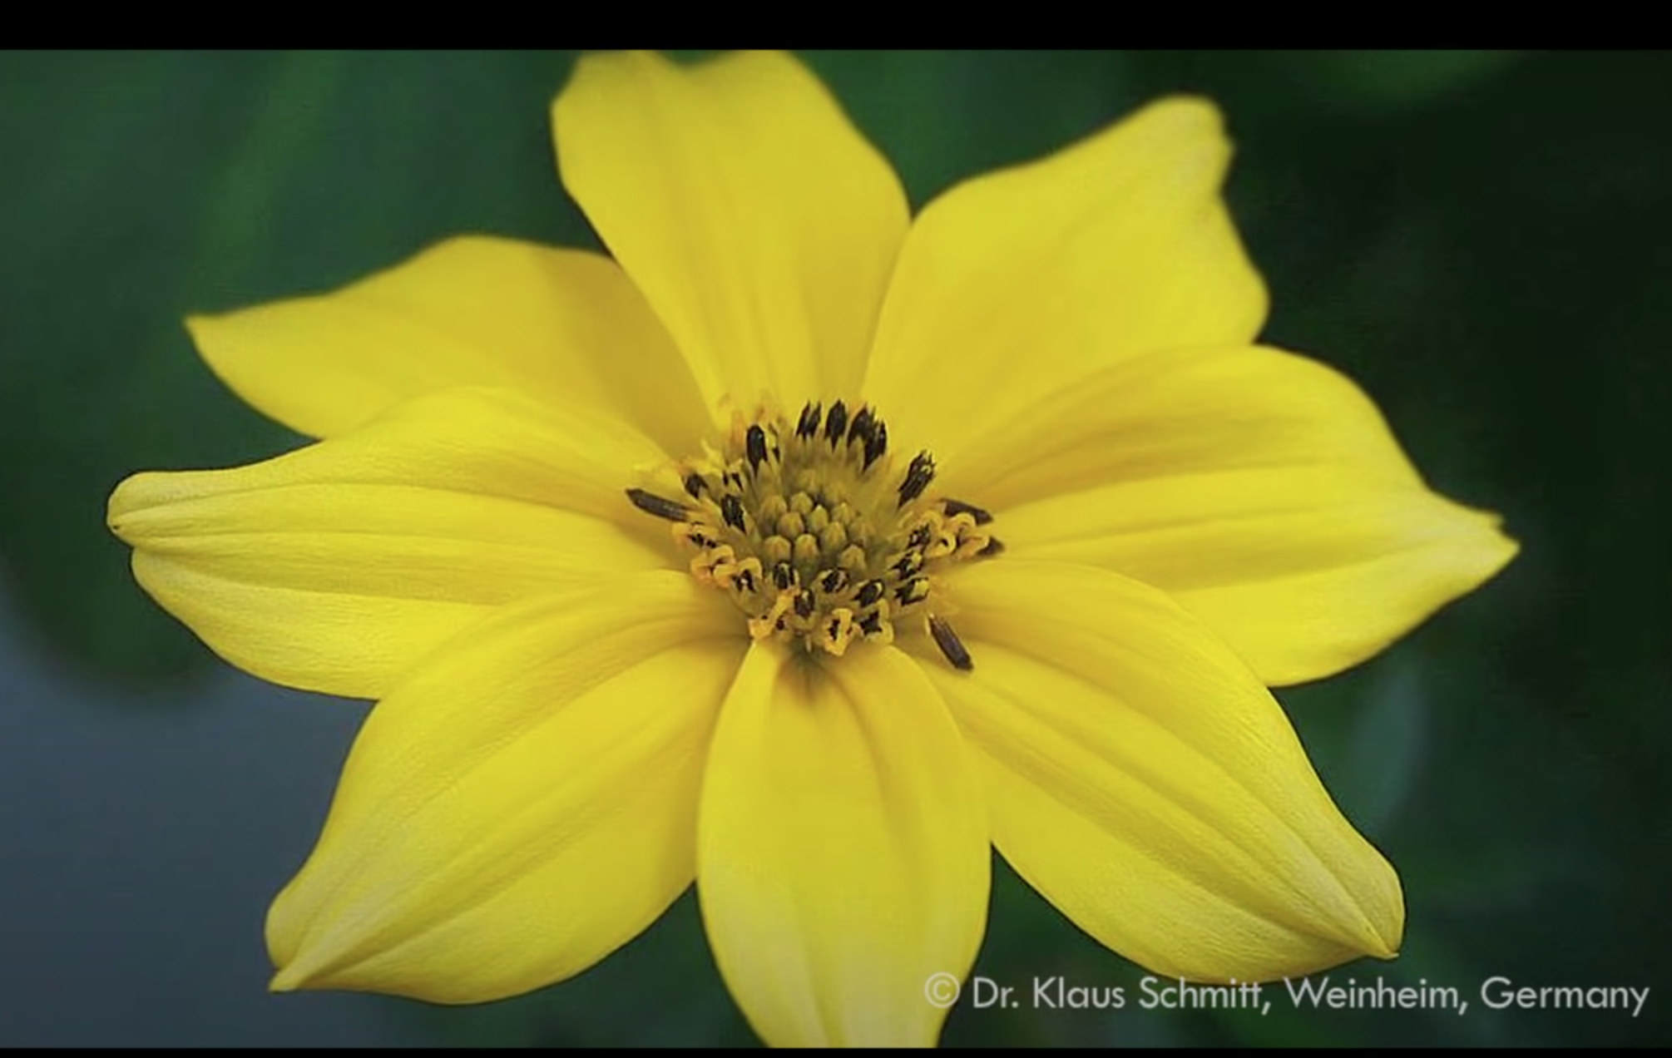
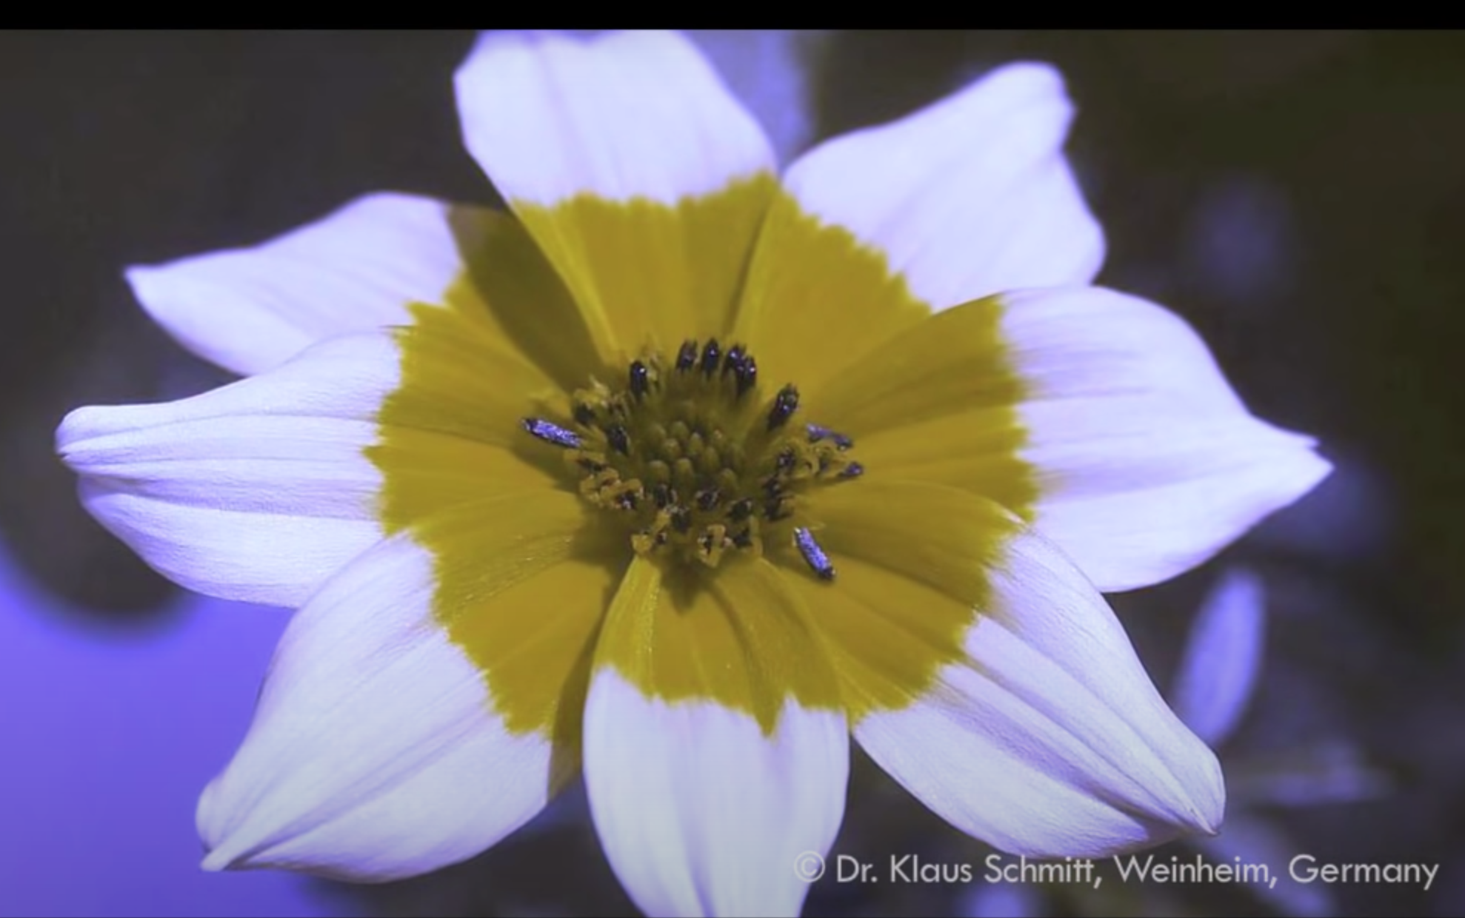
How do bees perceive?
Visible: Ultraviolet: (bees?)
The key’s in Ultraviolet imaging.
Visible: Ultraviolet:

Slide 50
Can bees not only plan, but imagine things?
They can certainly learn to associate visual patterns (such as those presented on flowers) with nectar rewards; but this doesn’t necessarily imply that they have a little image of flowers floating around in their head.
A 2017 study looked at artificial neural networks, modelled on bees’ brains, which deployed two simple feature detectors – that is, two kinds of neurons, each of which is especially sensitive to lines or edges that run in a particular direction. These algorithms were capable of recognising complex visual patterns, like a circle carved into four, with stripes running at different angles in each quadrant. So a bee could store these complex visual patterns just by memorising the signals from these neurons – without actually storing full images in its memory.

Slide 51
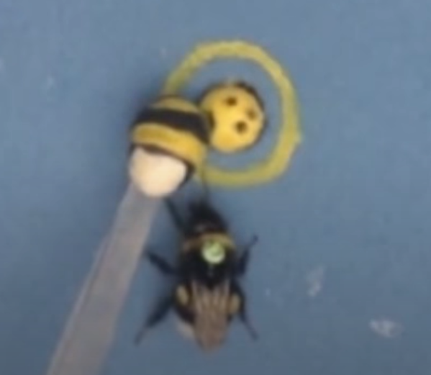
Cognitive flexibility - improving on observed behaviour
Tool use among bumblebees
Experiment:
Bumblebees were required to transport a small ball to a defined
location to receive a sugar reward.
The bees used social learning to solve the task by watching skilled
demonstrator bees: they observed that they could move one of three
possible balls (the furthest one from the centre) into the central reward
area to obtain the reward.
What did the observer bees do? When later tested on their own, the observer bees did not choose the furthest ball from the centre, but its closest one.
Training the bee

Slide 52
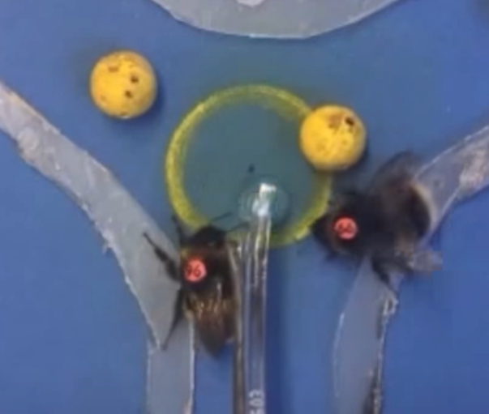
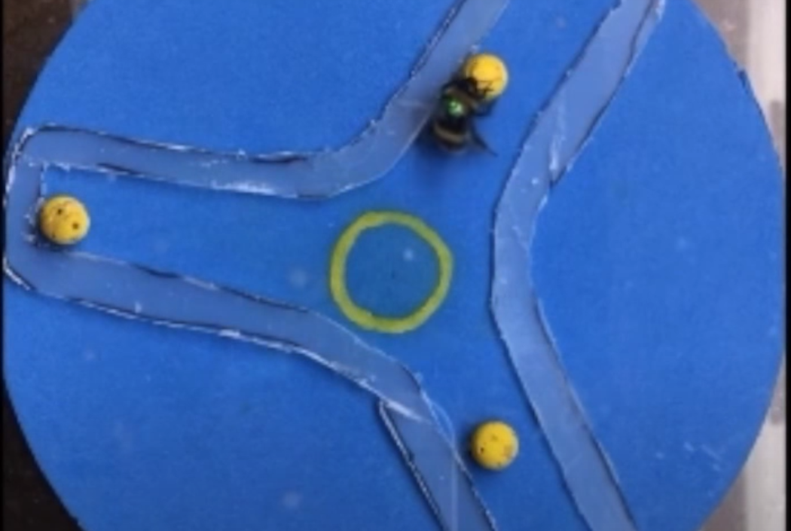
Are they really smart?
They did this even when the closest ball was coloured black instead of the yellow
they’d been trained on. Importantly, observers had no prior experience with rolling the balls themselves (that is, no opportunity for trial-and-error learning).
These results indicated that instead of simply ‘aping’ a learned technique, bumblebees spontaneously improved on the strategy used by their instructor.
They had an appreciation of the outcome of their actions.
Ball in the Goal!
Observer bee learning from the trained bee and then getting sugar as a reward
Bee chose the closest ball,not the furthest one

Slide 53
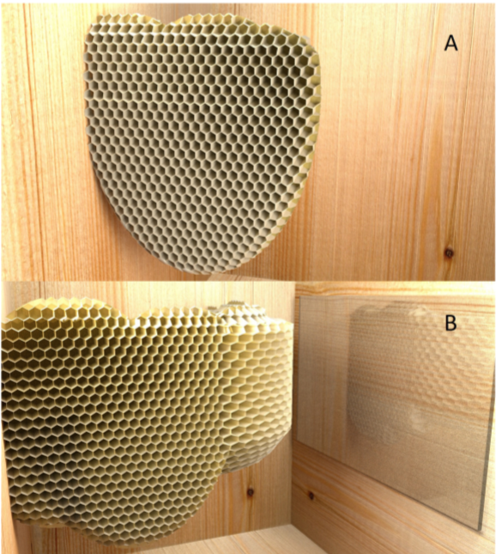
Decision Making in bees
Cognitive aspect of comb building:
While honeybees were busy building the (normally two-dimensional) honeycomb, Huber’s team placed glass panes into the path of the construction. (Glass is a poor surface on which to attach wax.)
The honeybees took corrective action long before they had reached the glass: they rotated the entire composition by 90 degrees so as to attach the comb to the nearest wooden surface. Apparently, the bees had extrapolated from their current location to the target zone, and tried to avoid a suboptimal result.

